Slide 1
Java/J2EE Session- 5
Object Oriented Concepts.

Slide 2
Contents
Encapsulation.
Inheritance.
Instanceof Operator

Slide 3
Encapsulation,
Encapsulation:
  Is the technique of making the fields in a class private and providing access to the fields via public methods. If a field is declared private, it cannot be accessed by anyone outside the class, thereby hiding the fields within the class. For this reason, encapsulation is also referred to as data hiding.
  The main benefit of encapsulation is the ability to modify our implemented code without breaking the code of others who use our code. With this feature Encapsulation gives maintainability, flexibility and extensibility to our code.
  We can access the private variables using the public methods.

Slide 4
Encapsulation
Benefits of Encapsulation
  The fields of the class can be made read only or write only
  A class can have a total control on what is stored in the fields
  The users of the class don’t know how the class stores the data.
  A class can change the data type of a field, and the users of the class do not need to change any of there code.
  Since private data members are not accessible out side the class we can read them or update them
  The methods should follow the Java Bean naming convention of set and get
  Encapsulation makes it easy to maintain and modify the code.

Slide 5
Encapsulation
package com.session4.test1;
public class EncapTest {
private int empNo;
private String empName;
private double salary;
public String getEmpName() {
return empName;
}
public void setEmpName(String empName) {
this.empName = empName;
}
public void setEmpNo(int empNo) {
this.empNo = empNo;
}
public int getEmpNo() {
return empNo;
}
public double getSalary() {
return salary;
}
public void setSalary(double salary) {
this.salary = salary;
}
public EncapTest()
{
empNo = 0;
empName = “Kiran”;
salary = 1000.00;
}
public EncapTest(int empno,String empName,double sal)
{
empNo = empno;
empName = empName;
salary = sal;
}
}

Slide 6

Any Questions on current topic
Next Topic
Inheritance

Slide 7
Inheritance
Inheritance can be defined as the process where one object acquires the properties of another.
By the use of Inheritance information is manageable in a hierarchical order.
We can achieve inheritance by using extends keyword
We cannot extend final classes.
The inheritance relationship can be any.
  IS-A Relation.
  HAS-A Relation.

Slide 8
Inheritance (IS-A Relationship)
If we consider the example beside.
Vehicle is called as Base or Super Class
Classes such as Car, Bus and Scooter are called as child or sub class
The relationship can be defined as
  Car IS-A Vehicle
  Bus IS-A Vehicle
  Scooter IS-A Vehicle
IS-A Relationship can be achieved by using extends keyword
public class Vehicle{}
public class Car extends Vehicle{ }
public class Bus extends Vehicle{ }
public class Scooter extends Vehicle{ }

Slide 9
Inheritance (HAS-A Relationship)
In this example we do have IS-A relationship between a Car and Vehicle by using extends keyword
But we don’t have any relation between a Car and Speed.
The relationship can be defined as
  Car HAS-A Speed
Even though we are not extending the speed class we are using the property speed from Speed class.
This kind of inheritance will have HAS-A relationship
public class Vehicle{}
public class Car extends Vehicle
{
private Speed speed;
}
Public class Speed { }

Slide 10
Inheritance
Features and Benefits of Inheritance
  Reusability: We can reuse the existing code in different classes by inheritance
  Flexibility: Inheritance can make the code flexible to change because class that inherit from the super class can be changed.
  A super class can store the instance of any of the child classes.
  Duplication : Inheritance will avoid duplication of code in several classes.

Slide 11
Inheritance (Resuability)
Class Vehicle
package com.session4.test1;
public class Vehicle
{
private int vehicleNo;
private String vehicleName;
private String vehicleModel;
public Vehicle()
{
vehicleNo = 0;
vehicleName = "";
vehicleModel = "";
}
public Vehicle(int vehicleNo,String vehicleName,String vehicleModel)
{
this.vehicleNo = vehicleNo;
this.vehicleName = vehicleName;
this.vehicleModel = vehicleModel;
}
public String getVehicleModel() {
return vehicleModel;
}
public void setVehicleModel(String vehicleModel) {
this.vehicleModel = vehicleModel;
}
public String getVehicleName() {
return vehicleName;
}
public void setVehicleName(String vehicleName) {
this.vehicleName = vehicleName;
}
public int getVehicleNo() {
return vehicleNo;
}
public void setVehicleNo(int vehicleNo) {
this.vehicleNo = vehicleNo;
}
}

Slide 12
Inheritance (Resuability)
Class Car
package com.session4.test1;
public class Car extends Vehicle
{
public Car()
{
super();
}
public Car(int number,String name,String model)
{
super(number,name,model);
}
}
Class Bus
package com.session4.test1;
public class Bus extends Vehicle
{
public Bus()
{
super();
}
public Bus(int number,String name,String model)
{
super(number,name,model);
}
}

Slide 13
Inheritance (Resuability)
InstanceOf: Some time knowing the type of the object at runtime is very much useful.
This is required because each and every object behave in a different way.
If we can find the type of object then we can implement the specific behavior for that object.
Using the instanceOf operator we can find to which object does the instance belong
The example beside will give a clear idea on how to use the instance of operator.
Instances named v and v1 are the objects of a class called Vehicle
But we can find the actual class that they belong is with the use of InstanceOf Operator
package com.session4.test1;
public class InherTest {
public static void main(String[] args) {
Vehicle v = new Car(1000,"Benz","2005");
Vehicle v1 = new Bus(1001,"Volvo","2006");
if(v instanceof Car)
{
System.out.println("The object v is the instance of Car...“+v.getVehicleName());
}
if(v1 instanceof Bus)
{
System.out.println("The object v is the instance of Bus..."+v1.getVehicleName());
}}}

Slide 14
Inheritance (Flexibility)
Class Car
package com.session4.test1;
public class Car extends Vehicle
{
public Car()
{
super();
}
public Car(int number,String name,String model)
{
super(number,name,model);
}
public int yearsOfPurchase(){
// calculate the no of years that the vehicle //has purchased and will return integer value
}
}
Class Bus
package com.session4.test1;
public class Bus extends Vehicle
{
public Bus()
{
super();
}
public Bus(int number,String name,String model)
{
super(number,name,model);
}
}

Slide 15
Inheritance (Flexibility)
If we observe the above code we have one new method called
  public int yearsOfPurchase()
This method is available in class Car but this method is not availabe in class called Bus
In this way the code in class Car is very much flexible to change without disturbing and code in the super class Vehicle.
Now the class Car is not only having the features for the parent class such as getting the vehicleNo, Name, Model.
It has also its own features like yearsOfPurchase() which is specific to class Car

Slide 16
Inheritance (Child class reference to Super class)
On of the great advantage of inheritance is
Super class can store the reference of the child class
In this example we can observe.
Vehicle is the super class for both Car and Bus
The statement
  Vehicle v = new Car(100,”B”,”2005”);
In the above statement Vehicle stores the reference of the child class.
We use the instanceOf operator to exactly know what child reference that the Vehicle class hold.
package com.session4.test1;
public class InherTest {
public static void main(String[] args) {
Vehicle v = new Car(1000,"Benz","2005");
Vehicle v1 = new Bus(1001,"Volvo","2006");
if(v instanceof Car)
{
System.out.println("The object v is the instance of Car...“+v.getVehicleName());
}
if(v1 instanceof Bus)
{
System.out.println("The object v is the instance of Bus..."+v1.getVehicleName());
}}}

Slide 17
Inheritance (Duplication)
Consider that we have not written any class called Vehicle.
The following 3 properties,
  Vehicle Number
  Vehicle Name
  Vehicle Model
Must be available in both of the below classes
  Car
  Bus
In this way the properties in class Vehicle are duplicated in 2 different classes called as Car and Bus
If there is any change in the property then we need to change these 2 classes. So, there is no flexibility of code
Let’s see the example in the next slide.

Slide 18
Inheritance (Duplication)
Class Car
package com.session4.test1;
public class Car
{
private int carNo;
private String carName;
private String carModel;
public Car()
{
carNo = 0;
carName = "";
carModel = "";
}
public Car(int carNo,String carName,String carModel)
{
this.carNo = carNo;
this.carName = carName;
this.carModel = carModel;
}
public String getCarModel() {
return carModel;
}
public void setCarModel(String carModel) {
this.carModel = carModel;
}
public String getCarName() {
return carName;
}
public void setCarName(String carName) {
this.carName = carName;
}
public int getCarNo() {
return carNo;
}
public void setCarNo(int carNo) {
this.carNo = carNo;
}
}

Slide 19
Inheritance (Duplication)
We will have pretty much the same class for the bus.
The bus class will also have all the 3 Getter and 3 Setter methods
The bus class will also have all the 3 properties.
To, conclude inheritance helps in code reusability, flexibility, and avoid duplicate code.
We are going to discuss about Types of Inheritance.

Slide 20
Inheritance
Types of Inheritance
  Single Inheritance
  Multiple Inheritance
  Multilevel Inheritance
  Hierarchical Inheritance

Slide 21
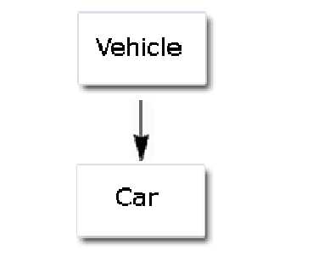
Single Inheritance
In Single Inheritance we have one parent class and one child class as depicted in this picture

Slide 22
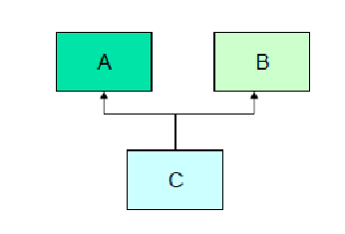
Multiple Inheritance
Java does not support Multiple Inheritance directly.
But it supports this kind of inheritance indirectly via the Interface.
Interfaces help us achieve Multiple Inheritance
Multiple inheritance means one child having more then one parent as shown in the image
But one among the class A or B must be interface.

Slide 23
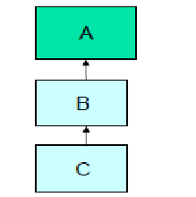
Multilevel Inheritance
In multilevel inheritance we have multiple levels in the inheritance hierarchy.
Like the child is having parent, parent is having one more parent and so on.
This is shown in this figure.

Slide 24
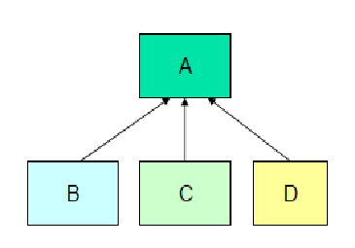
Hierarchical Inheritance
In Hierarchical inheritance many child’s will have same parent.
That means a single class is been extended by more than on child class
This is shown in the figure.

Slide 25
Any Questions on today’s session.

